Slide 1
Encoder & Decoder Architecture In Deep Learning

Slide 2
What is Sequential Data?
Sequential data consists of observations arranged in a temporal or logical order, where the position of each element affects its meaning.
In such data, each element typically depends on the elements that came before it.
Examples:
Linear pattern: x_{t} = x_{t-1}+ 2 → [2, 4, 6] ⇒ x₄ = 8
Text sequence: “He eats fruit” ≠ “Fruit eats he”.

Slide 3
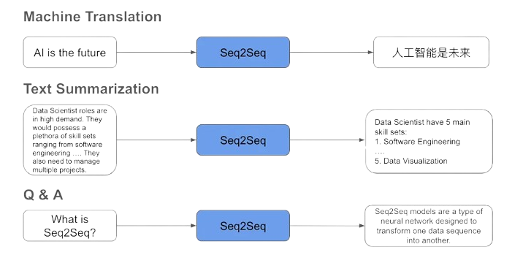

Slide 4
Why ANN Fails?
ANNs need fixed-size inputs
Seq2Seq sequences are variable length
Output also needs step-by-step generation
Cannot model temporal dependencies

Slide 5
Why Traditional RNN Fails?
Entire input compressed into one final hidden state
Information bottleneck for long sequences
Vanishing/exploding gradients
No mechanism for alignment

Slide 6
Need for a Different Architecture
Split into two modules:
Encoder → reads & represents input
Decoder → generates target
Supports variable-length input/output
Generates tokens step-by-step

Slide 7
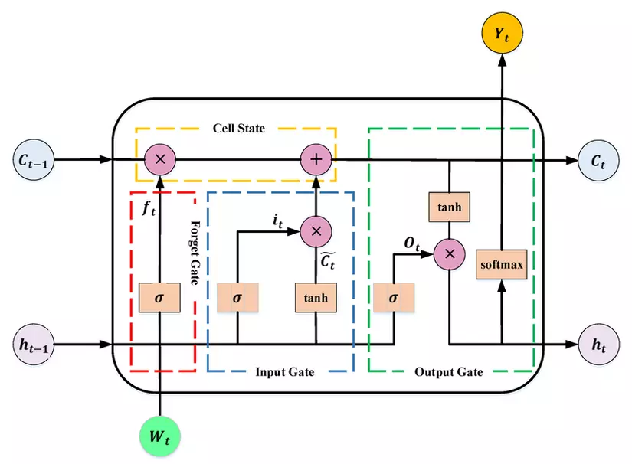
The Basic Block of Encoder Decoder
A type of RNN designed to handle long-term dependencies.
Contains a memory cell and three control gates — Forget, Input, and Output — to manage information flow.
Learns what to keep, what to forget, and what to output.
Widely used in NLP, speech, and time-series prediction tasks.

Slide 8
What is Encoder?
An encoder is a neural network component that converts raw input into a meaningful numerical representation.
It processes the input and learns the important features, compressing them into a smaller vector called the context vector.
This helps the model focus on the essential information while ignoring irrelevant details.
Examples: text encoding, feature extraction, sentence representation.
Real-life examples: language translation apps, speech-to-text systems, image captioning models.

Slide 9
What is Decoder?
A decoder is a neural network component that converts encoded representations into human-readable or task-specific outputs.
It takes the encoder's context vector and uses it to generate the final output.
It decodes the meaning in the vector and produces results step-by-step, conditioning on previously generated outputs.
Examples: sequence generation, text decoding, image reconstruction.
Common uses: image captioning, speech synthesis, chatbot responses.

Slide 10
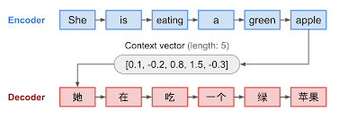
Example of working of Encoder and Decoder:

Slide 11
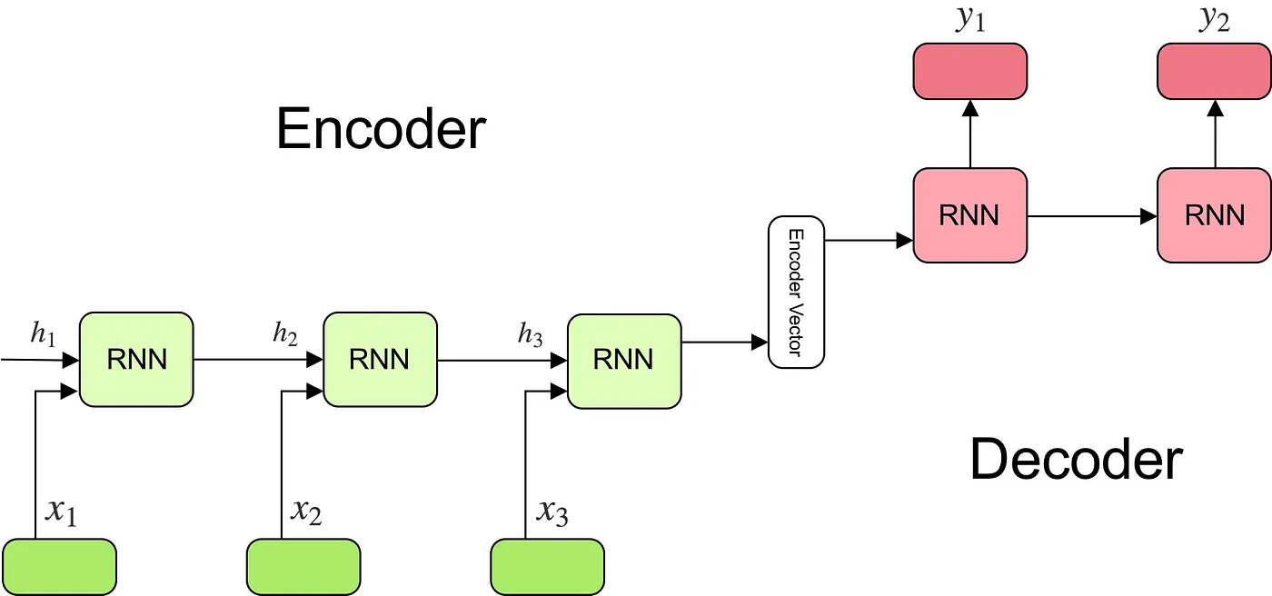
Encoder Decoder

Slide 12
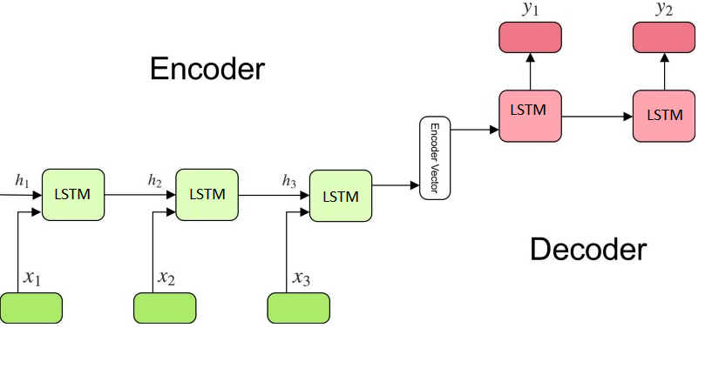
Encoder Decoder

Slide 13
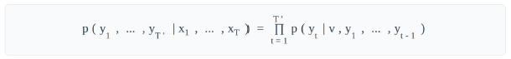
The Mathematical Model
•
The goal is to estimate the conditional probability: `p(y_1, ..., y_T' | x_1, ..., x_T)`
•
The encoder's final hidden state is the context vector, `v`.
•
The decoder is an LSTM-Language Model conditioned on `v`.
•
Probability Decomposition:
•
Each `p(y_t | ...)` is a single softmax layer.

Slide 14
Three Key Innovations
1.
Two Different LSTMs: One for the encoder, one for the decoder. This increases parameters and is better for multilingual tasks.
2.
Deep LSTMs: Used 4 layers of LSTMs. Deep LSTMs significantly outperformed shallow ones (each layer reduced perplexity by ~10%).
3.
Reversing the Source Sentence: This was a critical discovery for model performance.

Slide 15
The "Reverse" Trick
•
The Idea: Instead of mapping "A, B, C" → "W, X, Y", the model maps "C, B, A" → "W, X, Y".
•
Why? It introduces *short-term dependencies*.
•
In a normal setup, "A" (first input) is very far from "W" (first output).
•
By reversing, "A" is now very close to "W". This makes it *much* easier for SGD to "establish communication" between the input and output.
•
This simple trick was a key contribution and greatly improved performance.

Slide 16
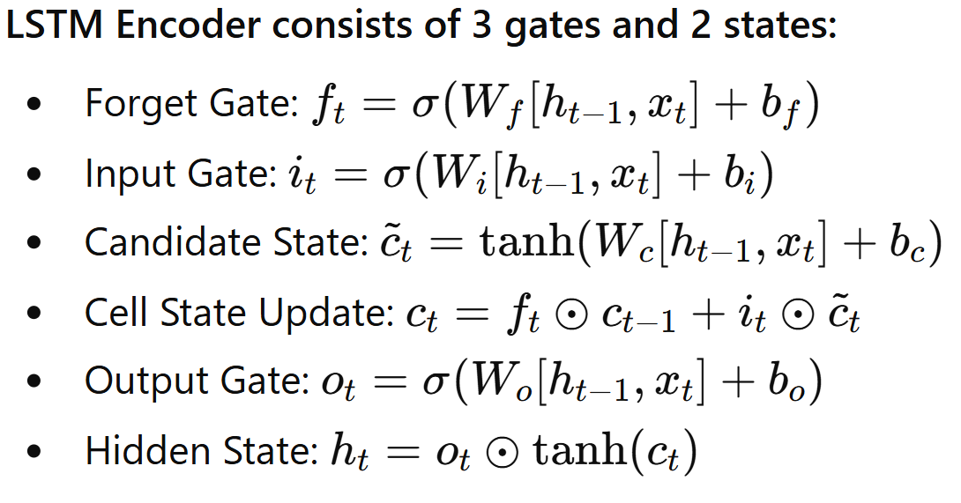
LSTM Equations

Slide 17
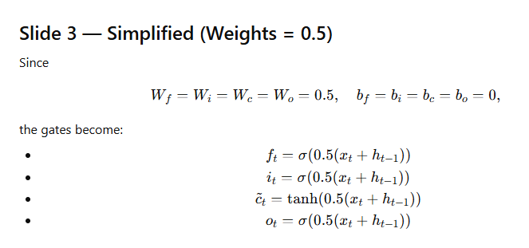
Example Setup

Slide 18
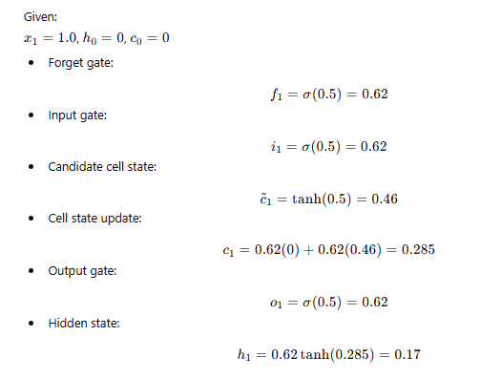
Step-by-Step Computation (t=1)

Slide 19
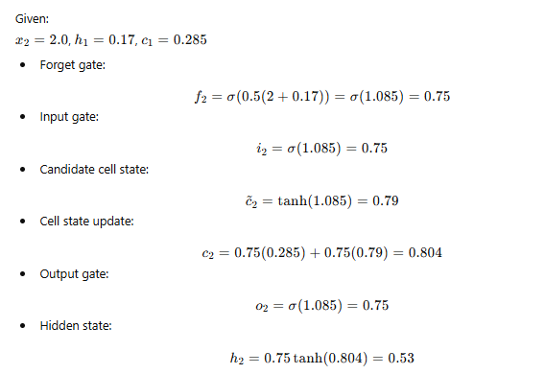
Step-by-Step Computation (t=2)

Slide 20
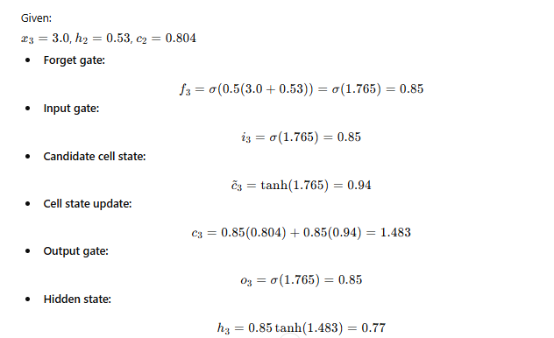
Step-by-Step Computation (t=3)

Slide 21
Final Encoder Output
Final LSTM Encoder Output:
Hidden states: h1=0.17, h2=0.53, h3=0.77
Final encoder representation = h3 = 0.77
This vector summarizes the whole input sequence.

Slide 22
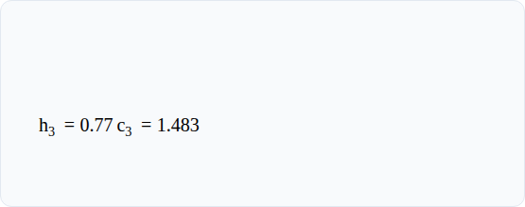
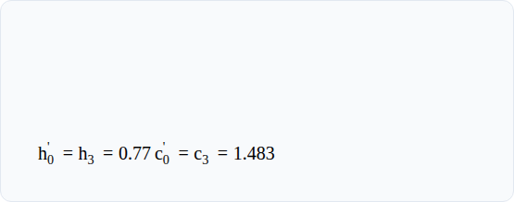
Decoder Setup & Initialization
Encoder's Final State (Context)
Decoder's Initial State
From the Encoder's final step (t=3):
This context vector becomes the initial state for the Decoder (at step t'=0):
Assumptions: We use the same weights ($W = 0.5$, $b = 0$) and a "Start-of-Sequence" (SOS) token input: x 1 ' = 0.0

Slide 23
Decoder Computation (t' = 1)
Inputs: h 0 ' = 0.77 , c 0 ' = 1.483 , x 1 ' = 0.0
f 1 ' = σ ( 0.5 × ( 0.77 + 0.0 ) ) = σ ( 0.385 ) ≈ 0.60
i 1 ' = σ ( 0.5 × ( 0.77 + 0.0 ) ) = σ ( 0.385 ) ≈ 0.60
c ~ 1 ' = tanh ( 0.5 × ( 0.77 + 0.0 ) ) = tanh ( 0.385 ) ≈ 0.37
c 1 ' = ( 0.60 × 1.483 ) + ( 0.60 × 0.37 ) = 0.890 + 0.222 = 1.112
o 1 ' = σ ( 0.385 ) ≈ 0.60
h 1 ' = 0.60 × tanh ( 1.112 ) = 0.60 × 0.805 ≈ 0.48
Output 1: y 1 = h 1 ' = 0.48

Slide 24
Decoder Computation (t' = 2)
Inputs: h 1 ' = 0.48 , c 1 ' = 1.112 , x 2 ' = y 1 = 0.48
f 2 ' = σ ( 0.5 × ( 0.48 + 0.48 ) ) = σ ( 0.48 ) ≈ 0.62
i 2 ' = σ ( 0.5 × ( 0.48 + 0.48 ) ) = σ ( 0.48 ) ≈ 0.62
c ~ 2 ' = tanh ( 0.5 × ( 0.48 + 0.48 ) ) = tanh ( 0.48 ) ≈ 0.45
c 2 ' = ( 0.62 × 1.112 ) + ( 0.62 × 0.45 ) = 0.689 + 0.279 = 0.968
o 2 ' = σ ( 0.48 ) <mo≈ 0.62
h 2 ' = 0.62 × tanh ( 0.968 ) = 0.62 × 0.748 ≈ 0.46
Output 2: y 2 = h 2 ' = 0.46

Slide 25
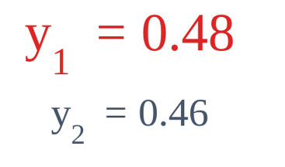
Final Decoder Output
Generated Output Sequence
The decoder generates an output at each time step. This process would continue until an "End-of-Sequence" (EOS) token is produced or a maximum length is reached.
The final generated sequence, based on the input context, is: (0.48, 0.46, ...)

Slide 26
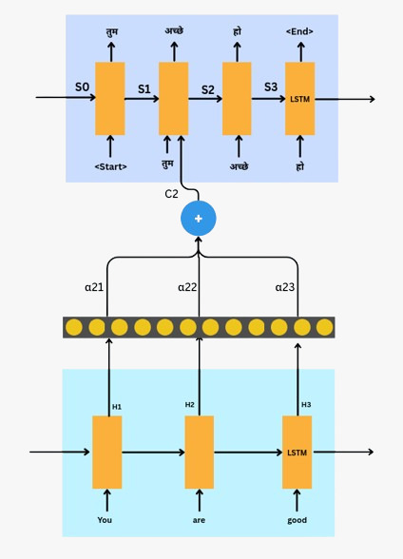
Attention removes encoder bottleneck limitation.
Encoder Decoder with attention mechanism
Attention removes encoder bottleneck limitation.
Attention compares decoder state with all encoder states.
Softmax gives attention weights, forming a context vector.
An artificial NN is used where inputs are current hidden state of encoder and previous hidden state of decoder.
The decoder uses this context to produce the next output word.

Slide 27
Attention Mechanism Working
Decoder Variables:
y_{i-1} : input to the decoder at time step i
s_{i} : decoder hidden state output at time step i
dec : length of decoder output sequence
e_{ij} : alignment score between decoder state s_{i} and encoder hidden state h_{j}
α_{ij} : attention weight (normalized score via softmax)
c_{i}: context vector for decoder at time step i
s^{l}_{i} : attentional hidden state (combined s_{i} and c_{i})
o_{i} : output logits at decoder step i
ŷ_{i}: predicted output token at decoder step i
Encoder Variables:
A vocabulary of 5 words: ["you", "are", "good", "is", "me"]
i : time step in the decoder
j : time step in the encoder
x_{j} : input word embedding to encoder at time step j
h_{j} : encoder hidden state output at time step j
enc : length of encoder input sequence

Slide 28
Initializations
Aim:
Input: “you are good”
Output: “तुम अच्छे हो”
Encoder embeddings
you → [1.0, 0.0, 0.0, 0.5]
are → [0.0, 1.0, 0.5, 0.0]
good → [0.8, 0.2, 0.0, 0.0]
is → [0.0, 0.6, 0.2, 0.1]
me → [0.9, 0.0, 0.1, 0.2]
Decoder embeddings
<start> → [0.0, 0.0, 0.0, 0.0]
तुम → [1.0, 0.0, 0.0, 0]
अच्छे → [0.0, 1.0, 0.5, 0.0]
हो → [0.5, 0, 0, 1]
<end> → [0.0, 0.0, 0.0, 0.0]

Slide 29
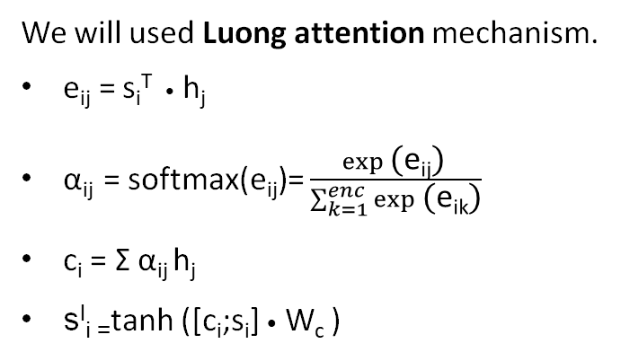
Training of Encoder-Decoder using attention
We will used Luong attention mechanism.
e_{ij}​ = s_{i}^{T} • h_{j}
α_{ij} = softmax(e_{ij})= $\frac{exp⁡\text{(}\text{e}\text{ij}\text{)} }{\sum_{k=1}^{enc}{exp⁡\text{(}\text{e}\text{i}\text{k}\text{)}}}$
c_{i} = Σ α_{ij} h_{j}
s^{I}_{i =}tanh ([c_{i};s_{i}] • W_{c} )
Hidden state outputs
After some LSTM calculations,
h₁ ("you") = [1.0, 0.0, 0.0, 0.5]
h₂​ ("are") = [0.0, 1.0, 0.5, 0.0]
h₃​ ("good") = [0.8, 0.2, 0.0, 0.0]
Let’s consider: s₁ = h₃ = [0.8, 0.2, 0.0, 0.0]
Step2: Softmax on scores
Step1: Compute scores
α₁₁ = softmax(e₁₁) = softmax(0.8) = 0.4106
α₁₂ = softmax(e₁₂) = softmax(0.2) = 0.2253
α₁₃ = softmax(e₁₃) = softmax(0.68) = 0.3641
e₁₁= s₁ • h₁=0.8⋅1.0 + 0.2⋅0 + 0⋅0+ 0⋅0.5=0.8
e₁₂= s₁ • h₂=0.8⋅0 + 0.2⋅1.0+ 0⋅0.5+ 0⋅0=0.2
e₁₃= s₁ • h₃=0.8⋅0.8 + 0.2⋅0.2 + 0⋅0 +0⋅0=0.64+0.04=0.68

Slide 30
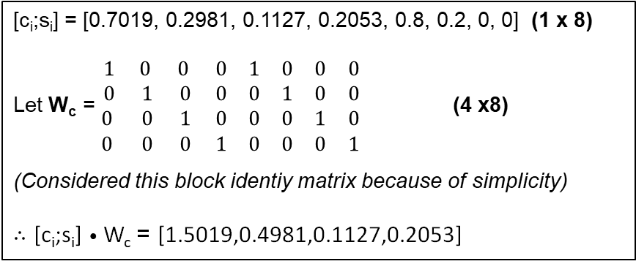
Step3: Compute attention vector
Step4: Compute [c_{i};s_{i}] • W_{c}
α₁₁ • h₁=0.4106⋅[1,0,0,0.5]=[ 0.4106, 0, 0, 0.2053 ]
α₁₂ • h₂=0.2253⋅[0,1,0.5,0]=[ 0, 0.2253, 0.11265, 0 ]
α₁₃ • h₃=0.3641⋅[0.8,0.2,0,0]=[ 0.2913, 0.0728, 0, 0 ]
So now from the formula: c_{i} = Σ α_{ij} h_{j}
c₁ = [0.4106+0+0.2913 , 0+0.2253+0.0728 ,
0+0.11265+0 , 0.2053+0+0]
= [0.7019,0.2981,0.1127,0.2053]​
[c_{i};s_{i}] = [0.7019, 0.2981, 0.1127, 0.2053, 0.8, 0.2, 0, 0] (1 x 8)
Let W_{c} = $\begin{matrix}1 & 0 & 0 & 0 & 1 & 0 & 0 & 0 \\ 0 & 1 & 0 & 0 & 0 & 1 & 0 & 0 \\ 0 & 0 & 1 & 0 & 0 & 0 & 1 & 0 \\ 0 & 0 & 0 & 1 & 0 & 0 & 0 & 1\end{matrix}$ (4 x8)
(Considered this block identiy matrix because of simplicity)
$∴$ [c_{i};s_{i}] • W_{c} = [1.5019,0.4981,0.1127,0.2053]
Step5: Compute tanh([c_{i};s_{i}] • W_{c} )
Loss_{1…dec} is calculated
Then L = ΣL_{i} is calculated
tanh(1.5019) ≈ 0.9050
tanh⁡(0.4981) ≈ 0.4593
tanh⁡(0.1127) ≈ 0.1122
tanh⁡(0.2053) ≈ 0.2026
s^{I} ₁= [0.9050, 0.4593, 0.1122, 0.2026]
Predicted word is “तुम”
( Teacher forcing is used initially )
Backpropagation is applied through the entire sequence
S_{2..dec} is calculated in same way

Slide 31
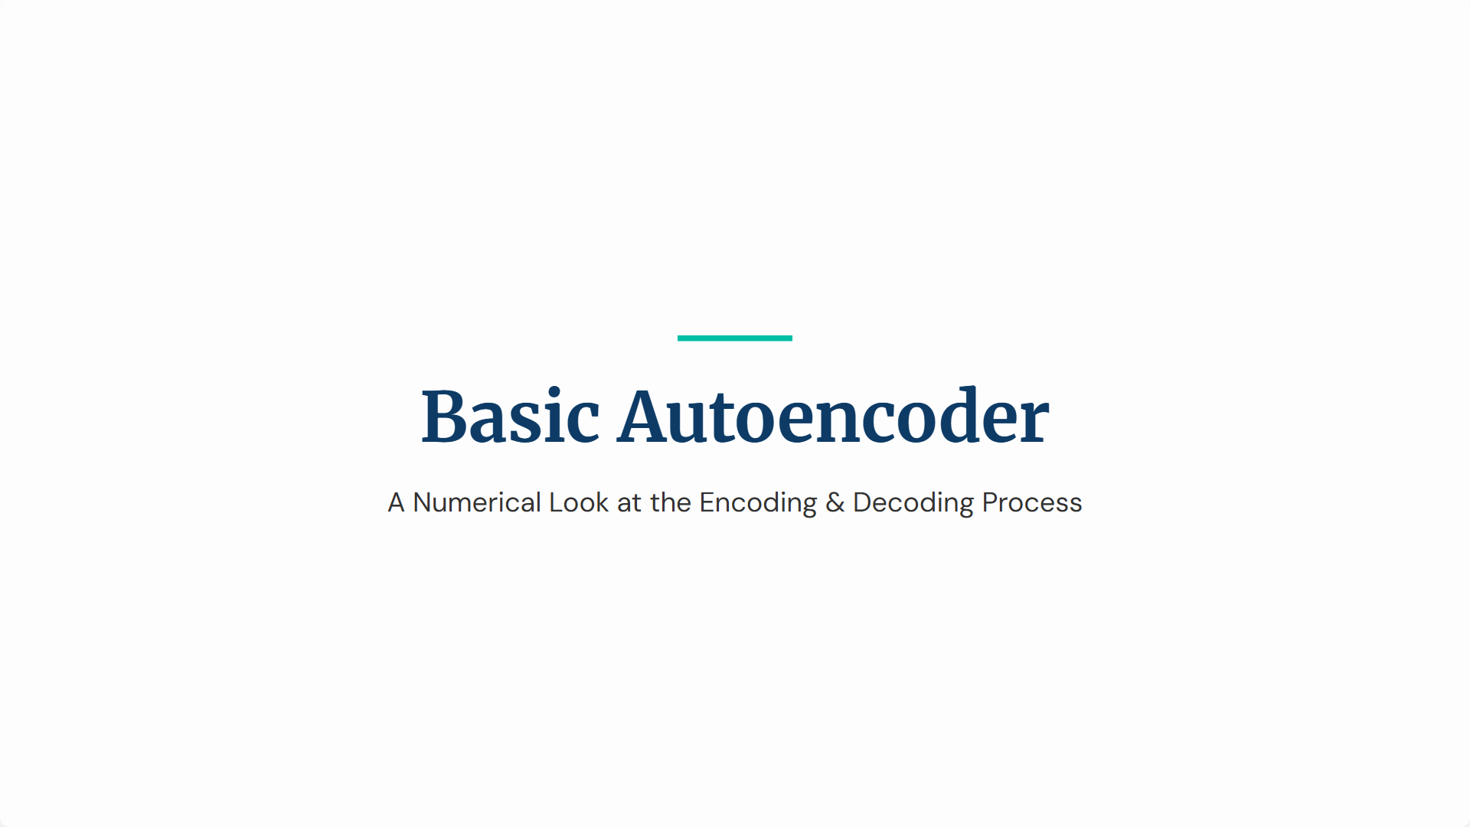

Slide 32
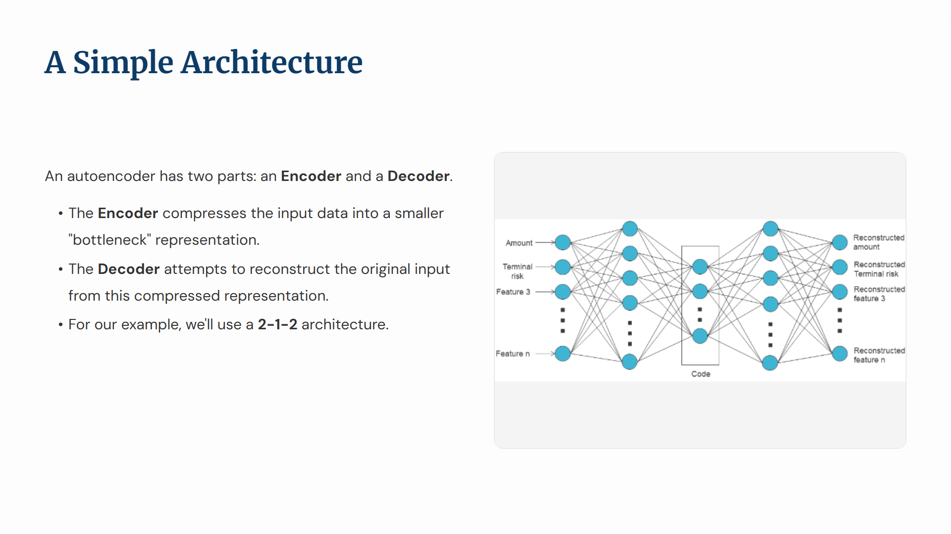

Slide 33
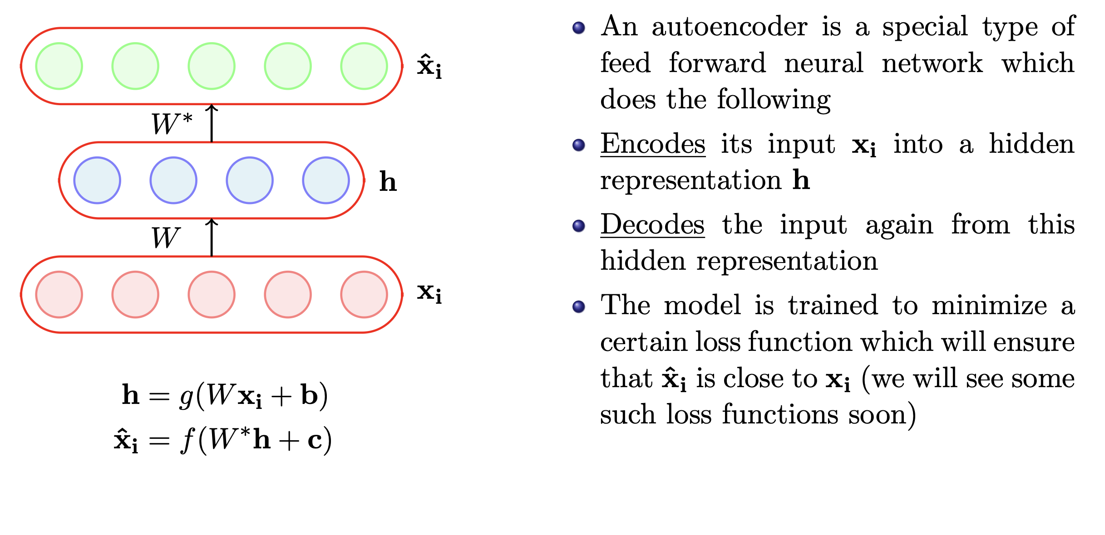

Slide 34
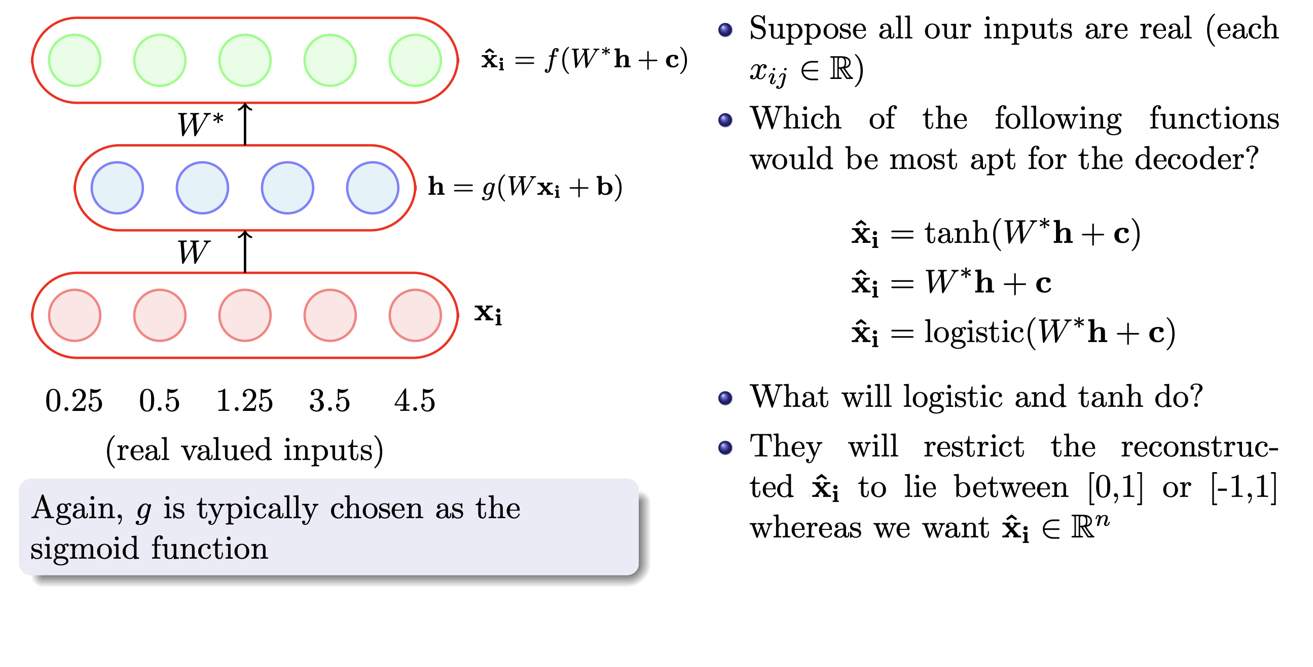

Slide 35
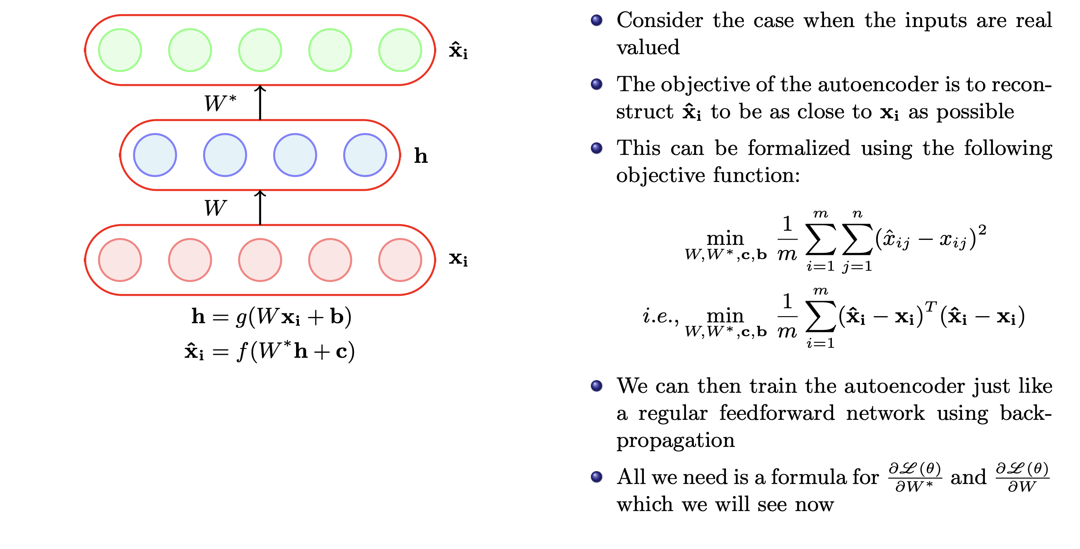

Slide 36
Denoising Autoencoder(DAE)
An autoencoder that receives a corrupted data point as input and is trained to predict the original, uncorrupted data point as its output.
Traditional autoencoders minimize L(x, g ( f (x)))
• where L is a loss function penalizing g( f (x)) for being dissimilar from x, such as L^2 norm of difference: mean squared error.
A DAE minimizes L(x, g(f(x) )
• where x is a copy of x that is corrupted by some form of noise
• The autoencoder must undo this corruption rather than simply copying their input

Slide 37
Why DAE?
• Avoid overfitting
• Learn robust representations

Slide 38
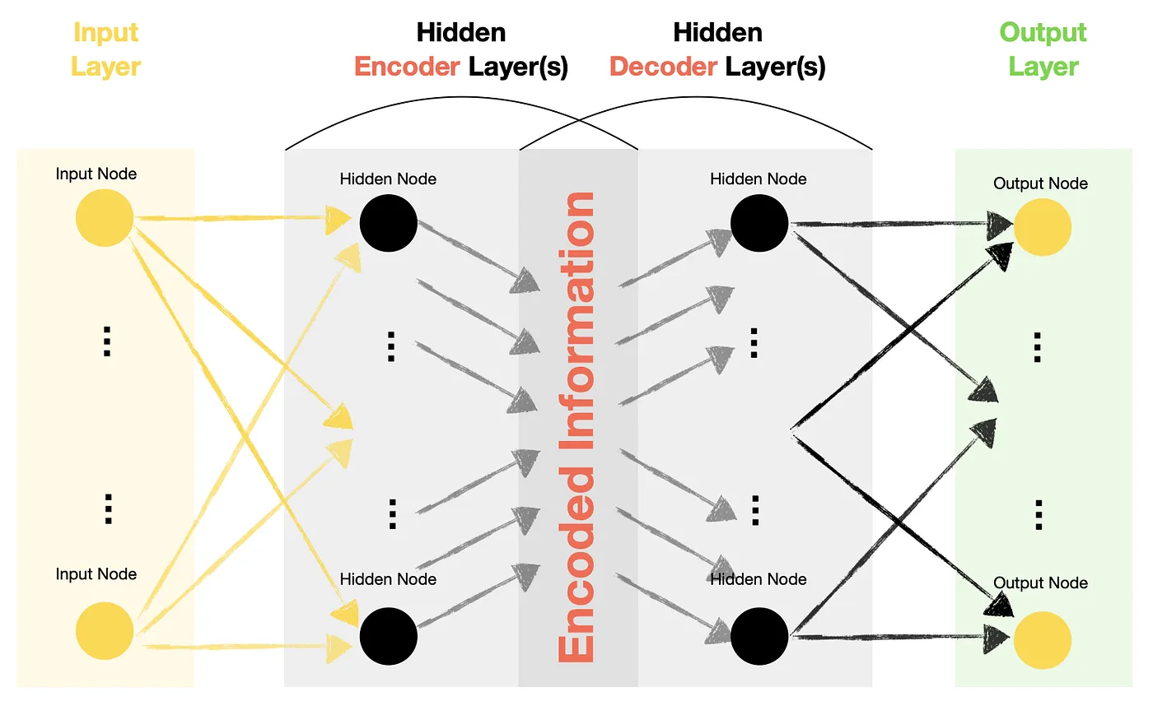
The structure of a DAE

Slide 39
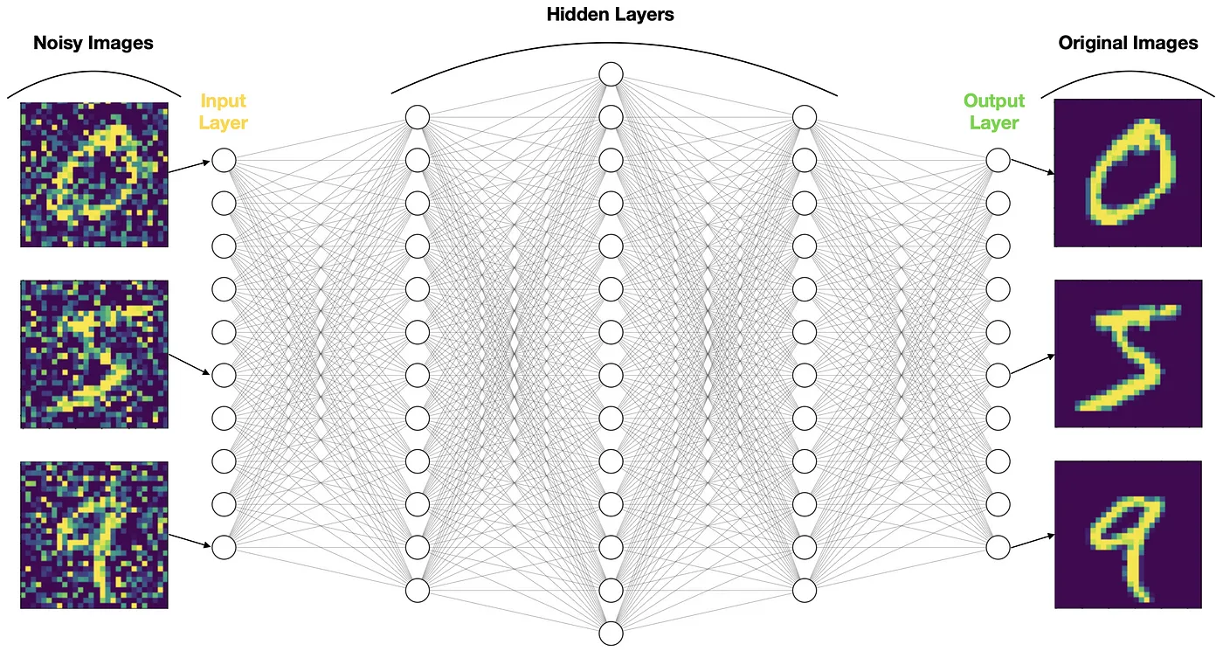
Denoising Autoencoder architecture:

Slide 40
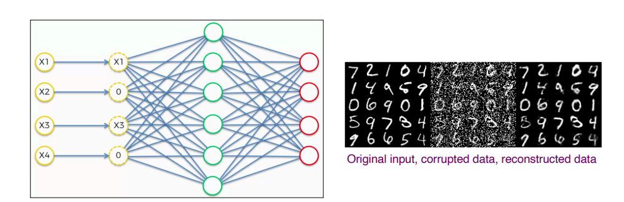
Example of Noise in a DAE
• An autoencoder with high capacity can end up learning an identity function (also called null function) where input=output .
• A DAE can solve this problem by corrupting the data input.
• How much noise to add?
• Corrupt input nodes by setting 30-50% of random input nodes to zero

Slide 41
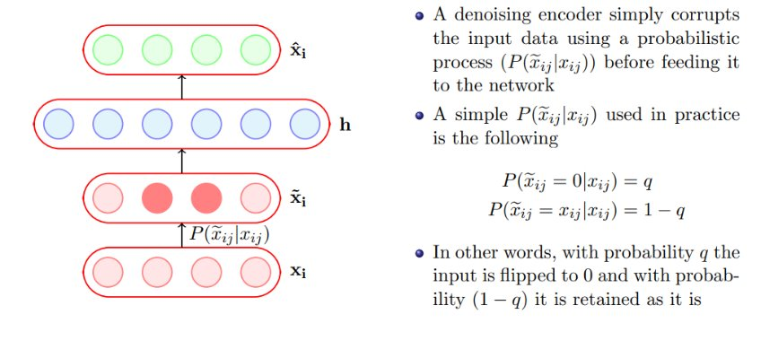

Slide 42
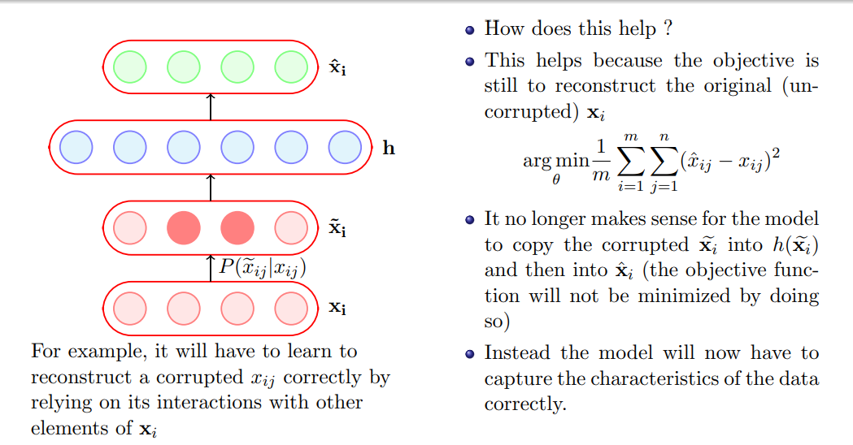

Slide 43
We will now see a practical application in which AEs are used and then compare Denoising Autoencoders with regular autoencoders

Slide 44
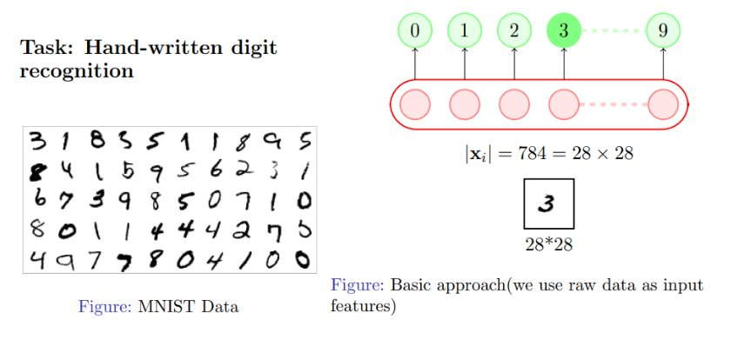

Slide 45
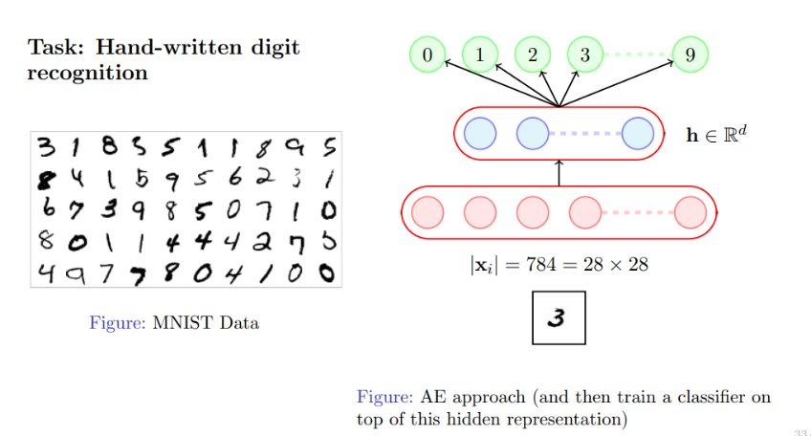

Slide 46
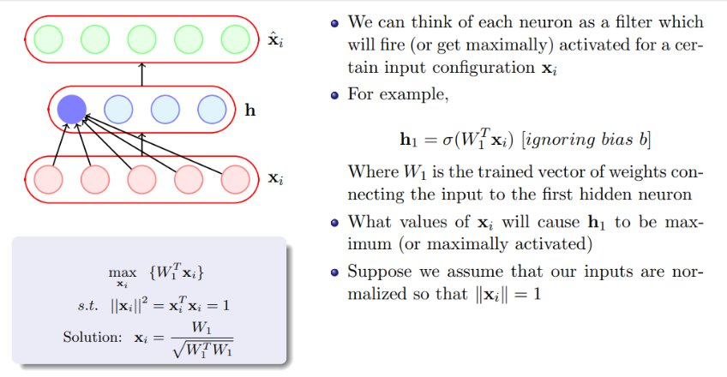

Slide 47
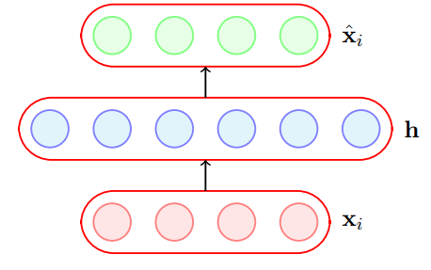
Sparse Autoencoder
Sparse autoencoders offer us an alternative method for introducing an information bottleneck without requiring a reduction in the number of nodes at our hidden layers. Instead, we’ll construct our loss function such that we penalize activations within a layer.

Slide 48
A hidden neuron with sigmoid activation will have values between 0 and 1.
We say that the neuron is activated when its output is close to 1 and not activated when its output is close to 0.
A sparse autoencoder tries to ensure the neuron is inactive most of the times.
If the neuron l is sparse (i.e. mostly inactive) then ˆρl → 0 .
A sparse autoencoder uses a sparsity parameter ρ (typically very close to 0, say, 0.005) and tries to enforce the constraint ˆρl = ρ.

Slide 49
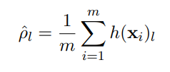
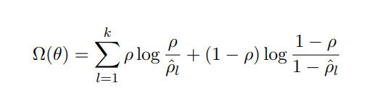
The average value of the activation of a neuron l is given by .
One way of ensuring this is to add the following term to the objective function
When will this term reach its minimum value and what is the minimum value? Let us plot it and check

Slide 50
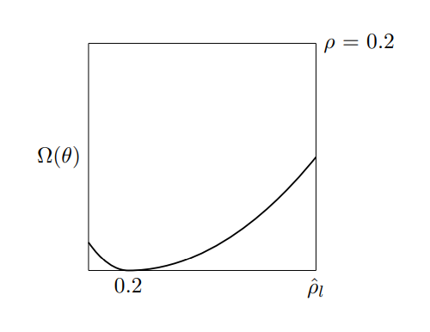

The function will reach its minimum value(s) when ˆρl = ρ.

Slide 51
Now, Lˆ(θ) = L (θ) + Ω(θ)
L (θ) is the squared error loss or cross entropy loss and Ω(θ) is the sparsity constraint.
We already know how to calculate ∂L (θ)/ ∂W
Let us see how to calculate ∂Ω(θ) /∂W .
Finally, ∂Lˆ(θ)/ ∂W = ∂L (θ)/ ∂W + ∂Ω(θ) /∂W (and we know how to calculate both terms on R.H.S)

Slide 52
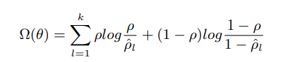
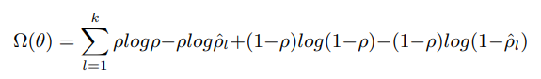
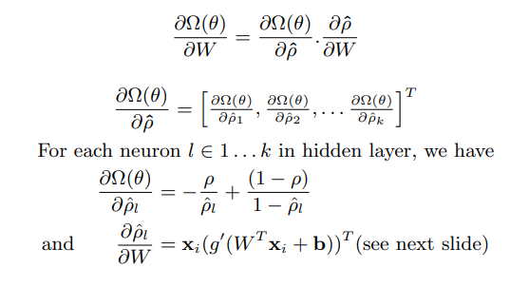
Can be re-written as:
By Chain rule:

Slide 53
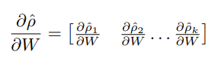
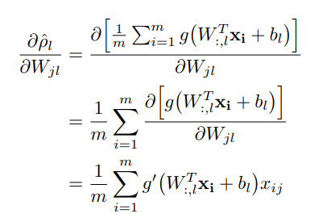
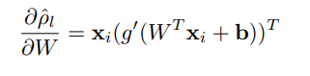
Derivation
For each element in the above equation we can calculate ∂ρˆl/∂W (which is the partial derivative of a scalar w.r.t. a matrix = matrix). For a single element of a matrix Wjl:-
So in matrix notation we can write it as :

Slide 54
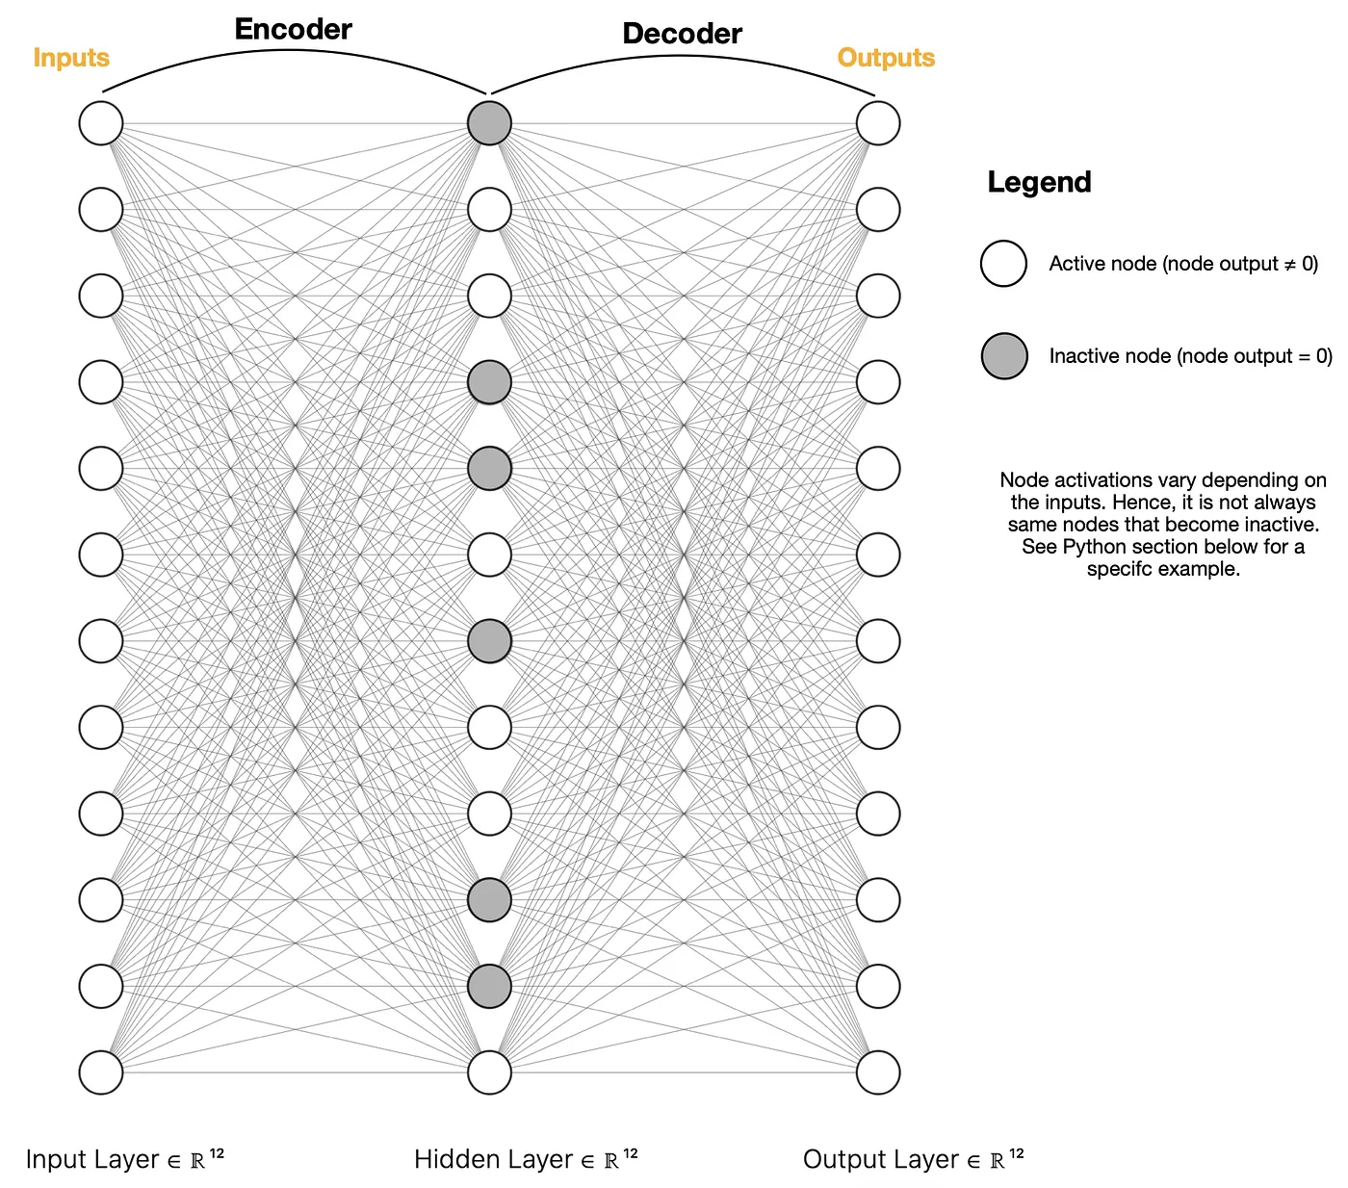
Sparse Autoencoder (SAE) architecture.

Slide 55
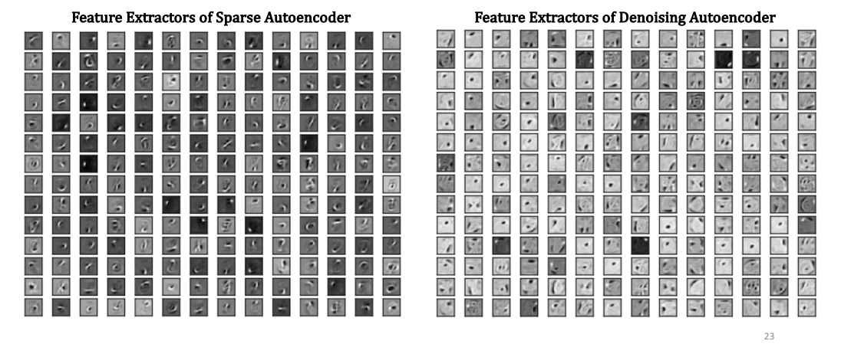
Sparse Autoencoder vs. Denoising Autoencoder

Slide 56
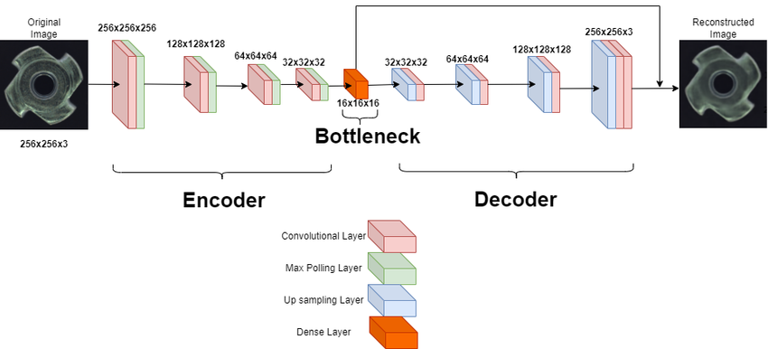
Contractive Autoencoder (CAE)

Slide 57
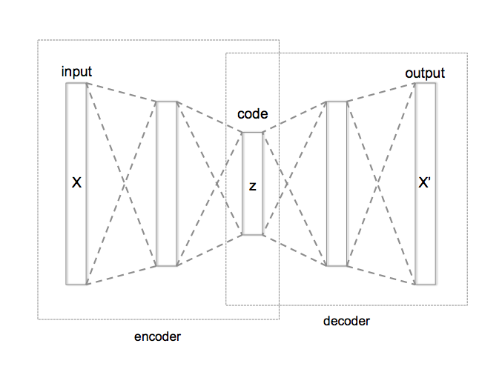
Recap: The Standard Autoencoder (AE)
Purpose: Unsupervised learning to discover a compact, latent representation (h) of input data.
Architecture:
Encoder:
h = f(x) (maps input to latent space)
Decoder:
x ̂= g(h) (reconstructs input from latent space)
Loss Function: Minimizes the reconstruction error.
L_{AE}(x, x ̂) = ||x – x ̂||²
Key Challenge: If the latent space capacity is too high, the autoencoder can simply learn the identity function without extracting meaningful features.

Slide 58
Contractive Autoencoder (CAE) - The Idea
Problem Addressed: Standard AEs can be too sensitive to minor input variations; the latent representation might change drastically.
Goal: Make the latent representation h robust to small, infinitesimal perturbations of the input x.
How: Add a contractive penalty to the loss function that directly penalizes large derivatives of the latent representation with respect to the input.
Intuition: If you slightly move pixels in an image, the CAE wants the latent code to remain very similar, rather than creating a completely new code. It forces the encoder to 'contract' the manifold of observed data.

Slide 59
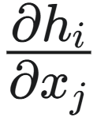
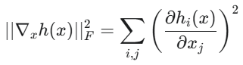
Contractive Autoencoder (CAE) - The Math
Encoder Output (Latent Space): h = f(x)
Total Loss Function: Combination of reconstruction loss and a contractive penalty.
L_{CAE}(x, x ̂) = ||x - x ̂||² + λ ||∇_{x} h(x)||²_{F}
Breakdown of the Contractive Penalty:
λ : A hyperparameter controlling the strength of the contractive penalty.
∇_{x} h(x) : The Jacobian matrix of the encoder's output $h$ with respect to its input x. It's a matrix where each element (∇_{x} h(x)) is .
|| . ||²_{F}: The squared Frobenius norm of the Jacobian matrix, which is the sum of the squares of all elements in the Jacobian.
Goal of Penalty: Penalizes rapid changes in h for small changes in x, enforcing local constancy of the latent representation.

Slide 60
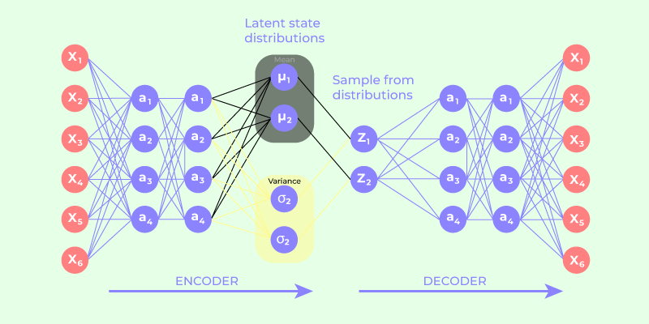
Variational Autoencoder (VAE) - The Idea

Slide 61
Variational Autoencoder (VAE) - The Idea
Problem Addressed: Standard AEs create a discontinuous latent space. Randomly sampling from this space usually yields nonsense.
Goal: Learn a continuous, structured, and generative latent space.
Ensure that nearby points in the latent space correspond to similar data points in the input space.
Allow for meaningful data generation by sampling from the latent space.
How: Instead of encoding input x into a single point h, the encoder encodes it into the parameters (mean μ and standard deviation σ) of a probability distribution.
The decoder then samples a latent vector z from this distribution to reconstruct x.
Intuition: For each input, the VAE defines a 'cloud' of possible latent codes, pushing these clouds to be compact and well-behaved, allowing for smooth interpolation and generation.

Slide 62
Variational Autoencoder (VAE) - The Math
Part 1: Reparameterization
Encoder Output: For each input x, the encoder outputs two vectors (typically for a Gaussian distribution):
Mean (μ): Vector representing the center of the latent distribution.
Log Variance (log σ²⁾: Vector representing the spread/variance. (σ is std dev, we use log variance for numerical stability).
Sampling Latent Vector (z):
Direct random sampling is not differentiable, which is a problem for backpropagation.
Reparameterization Trick: We sample from a simple distribution (e.g., standard normal N(0, 1) and transform it using the encoder's outputs.
This trick makes the sampling process differentiable, allowing gradients to flow back through μ and log σ².

Slide 63
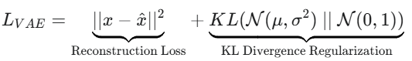
Variational Autoencoder (VAE) - The Math
Part 2: Loss Function
The VAE Loss Function (ELBO - Evidence Lower Bound):
1. Reconstruction Loss: (Same as standard AE)
Ensures the decoder can accurately reconstruct the original input x from the sampled latent vector z.
2. KL Divergence Regularization:
KL(P || Q): Measures how one probability distribution (P) diverges from a second, expected prior distribution (Q).
Here, P = N(μ, σ²) (the latent distribution generated by the encoder for input x).

Slide 64
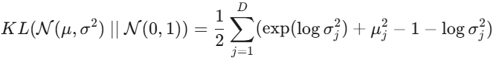
Variational Autoencoder (VAE) - The Math
Part 2: Loss Function
Q = N(0, 1) (the desired standard normal distribution in the latent space).
Goal: Forces the encoder to learn latent distributions that are close to a simple, continuous standard normal. This prevents 'gaps' in the latent space and ensures smooth interpolations for generation.
Formula for KL Divergence between two Gaussians:
(where D is the latent dimension)

Slide 65
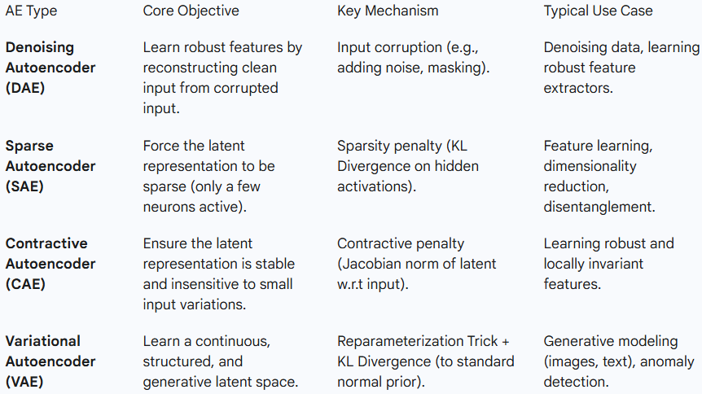
Summary: AE Type Comparison

Slide 66


Slide 67
Thank You

